Slide 1
Module 3: Using files and directories
Where is my data?
3: Using files and directories
4: Editing text
5: Bash

Slide 2
Contents
Directories
Files
Commands
i-nodes
Links
Notes:
In the Linux and Unix world, everything is a seen as a FILE (commands, devices, logs, data and even directories are stored as a file). So, we need to understand what they are and how to use them.

Slide 3
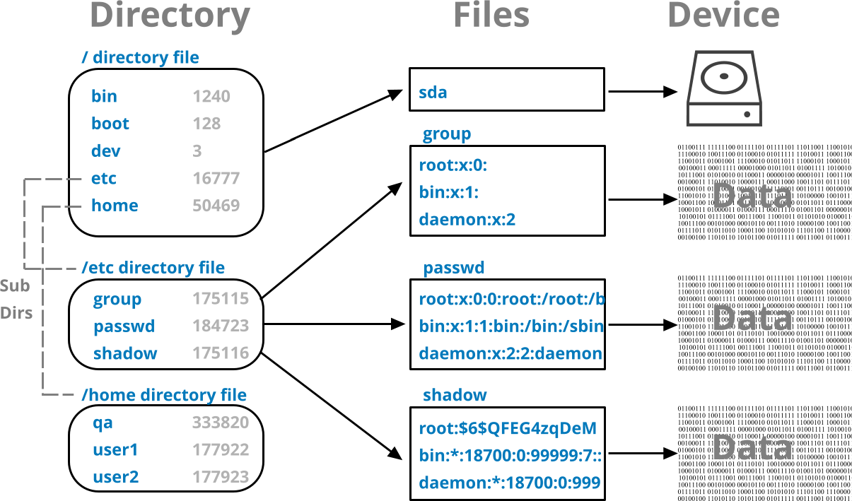
Files and directories
Notes:
In Linux, everything is treated as a file, including regular files, directories, devices, and even system processes.
Directories are special files that act as containers for other files and subdirectories, forming a hierarchical structure.
Each file and directory is represented by an inode (index node), which stores metadata such as:
File type (regular file, directory, symbolic link, etc.).
Permissions and ownership.
File size and timestamps.
Pointers to the actual data blocks on disk.
The relationship between directories and files is maintained using inode references, allowing for efficient file management.
Even hardware devices and system information (e.g., /dev/sda for disks, /proc/cpuinfo for CPU details) are accessed like files, ensuring a consistent interface for interacting with the system.

Slide 4
Directories

Slide 5
What are directories?
file1
This is a data file, containing some text
directory
file1 file2 dir1 file3 dir2
file6 file7 dir3 file3 dir4
sub-directory, dir1
file3
This is a data file, containing more text, or a program
Notes:
Data and programs are stored in files. Files are organized, using directories, into a hierarchical or tree-like structure.
A directory is in fact a special type of file that contains information about other files.
Directories can contain other directories as well as files, so that the hierarchy can be many levels deep.
There may be any number of files and directories in a directory, and there is no limit to the number of levels in the hierarchy.
UNIX/Linux has taken the concept of a file one step further than many operating systems: under Linux/UNIX everything is a file.
The physical devices in the system are accessed using special filenames in the file system.
Under some implementations, system memory and the currently-running processes (or programs) are also accessible through the file system.

Slide 6
Directory names
Directory names can contain any ASCII characters except / - it is the separator
However, many characters can create difficulties
Recommended to use alphanumeric, dot, dash and underscore characters.
Up to 255 characters long
Dots and underscores are treated as literal characters
Directory whose names beginning with a dot are special
Not displayed in directory listings by default
Notes:
Directory names can contain any ASCII characters except /. This includes symbols, non-printing characters, spaces and tabs.
File and directory names that begin with . (dot), such as: .bash_profile or .bashrc are often treated specially. We will see more of this later.
Although any characters are allowed in a directory name, in practice there are some characters that can cause difficulty, and these should be avoided if possible.
Examples are:
A hyphen “-” as the first character in a name.
Characters such as ?, *, (, ), &, [, ], >, <, space and tab (these have special meaning on a command line).
Non-printing ASCII characters.

Slide 7
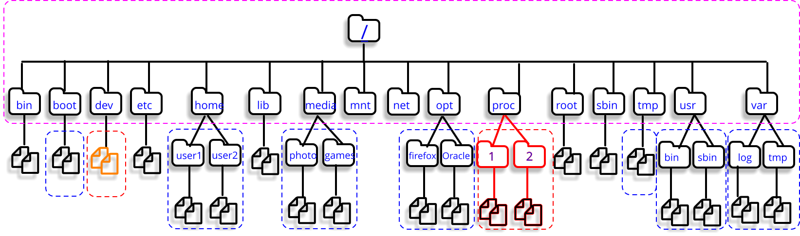
The Linux / Unix filesystem hierarchy
See File System Hierarchy Standard - https://www.pathname.com/fhs/
Notes:
This slide shows a typical Linux system directory tree concentrating on the directories which will be discussed in this course.
/bin essential binary programs to system operation
/sbin system bin, mostly admin executables
/etc system configuration files and some system executables
/home user accounts (home directories)
/tmp temporary directory; used by host of utilities, such as pg, vi, etc.
/var volatile information used for spool files, logs, requests, mail, etc.
/proc virtual filesystem in memory, with the kernel, processes, etc state
/dev the devices directory containing 'special' files, referring to all devices
/boot a directory with Linux kernel(s) and boot configuration files
/usr user related programs and libraries
The file system is described in more detail at the File System Hierarchy Standard (FHS):
https://www.pathname.com/fhs/

Slide 8
The ‘.’ directories
Special dot directories
Provide a mechanism to traverse up filesystem tree
Notes:
Every directory in the Linux file system has two special entries, with names “.” and “..”. These are shorthand ways of referring to:
“this directory”.
“the parent of this directory”.
These shorthands can be used anywhere in a pathname, relative or absolute. They are clearly of most use in relative pathnames, since they allow us to specify paths that traverse upwards through the hierarchy as well as downwards.

Slide 9
Specifying files and directories
The single dot . means this directory.
The double dot .. means the parent of this directory.
The forward slash is the root directory or separator.
Notes:
For example, in the slide, the current directory: /home/user2
From here, the relative path to the directory /home is: ..
Therefore, the relative path to the directory /home/user1 is: ../user1
Similarly, we can specify a relative path to a file in our current directory.
For example, the file Romeo.txt can also be referred to using: ./romeo.txt
The ./ prefix can also be useful if the filename starts with a minus, as a command would normally treat a leading minus as a command option, or if it’s an executable file not included in the PATH search variable.

Slide 10
Absolute vs. relative paths
Absolute paths
Start with a / (or decode to something that does)
They are the route from the / directory to the target
Stay the same regardless of your current location
/home/qa/romeo.txt
Relative paths
Never start with a /
Often shorter
They are the route from your current location to the target
Thus, they will change if your location changes
./romeo.txt
Characters | Which absolute path
~ | Current users home directory
~username | Specific user’s home directory
~+ | Current directory
~- | Previous directory

Slide 11
Knowledge check
Which of these are relative or absolute paths?
/home/user1
./fred
../../etc/passwd
/var/log
country.txt
~
Notes:
Answers:
Absolute (user1’s home directory0
Relative (fred in the current directory)
Relative (up to directories then down into etc to get to passwd)
Absolute (where the log files are)
Relative (country.txt in the current directory)
Absolute (your home directory)

Slide 12
Working and home directories
The working directory is a notion of “here”.
Use the pwd command to show it
It displays current working directory
Needed when working out relative paths
Use the shell cd command to change working directory:
Every user on the system has a home directory.
It is the shell's working (current) directory on login
Home directory contains user’s own files
Can freely create or remove files and directories here
Also holds user configuration files
Command | Action
cd directory-name | move to directory-name
cd .. | move to the parent directory
cd | move to the user's home directory
Notes:
Every user has a “home directory”, which has a number of uses.
It is the current directory when a user signs into an interactive shell, and it stores user specific configuration files.
The names of the configuration files depend on the applications in use but usually start with a dot.
Normally a user's files will reside in their home directory, but any other directory may be used provided the user has sufficient permissions. Home directory contents is normally protected from other users, although (of course) this limitation does not apply to the super user.
Every task running on Linux on our behalf has a current working directory. When we first login to a shell this is the user's home directory, and our tasks 'inherit' this location. But of course, we often want to navigate elsewhere – so we use the cd command to achieve this.
When used without an argument, cd places the user in his/her home directory. The shell built-in cd command alters the PWD and OLDPWD variables which could be included in the shell prompt to highlight the current directory.

Slide 13




Advanced: Pushd and popd
Change directories and change back
To display those on stack
$ pushd /var/log
/var/log ~
$ pushd /home
/home /var/log ~
$ pushd /etc/init.d
/etc/init.d /home /var/log ~
$ popd
/home /var/log ~
$ popd
/var/log ~
$ popd
~
/etc/init.d
/home
$ dirs
/etc/init.d /home /var/log ~
/var/log
~
Notes:
The BASH (Bourne Again Shell) has numerous built-in commands and features that provide convenient time saving features to the user.
One such feature is the “directory” stack which is accessed by the push, popd and dirs built-in shell commands.
The pushd command can change directory but will also save the directory into a stack (basically a record of directories).
Whilst working in a directory the popd command can be used to change back into the previous working directory by using and removing the last entry on the directory stack.
Continuous use of the popd command changes back to previous entries stored on the stack.
The dirs built-in shell command can be used to display the directories still remaining in the stack.
To display the directory stack one entry per line:- # dirs –p
To clear the directory stack:- # dirs –c

Slide 14
Files

Slide 15
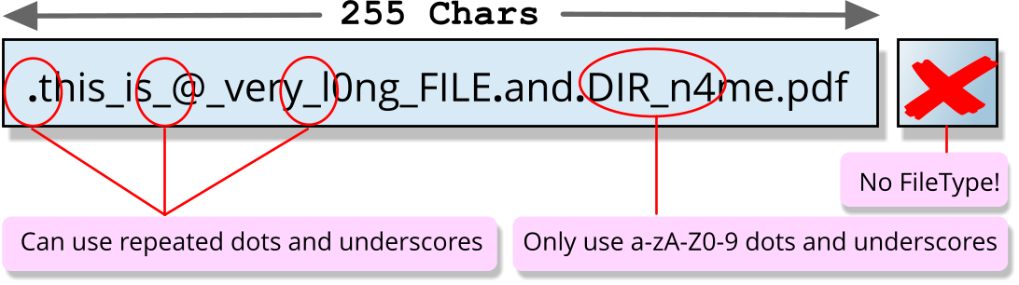
Filenames
Filenames can contain any ASCII characters except /.
However, many characters can create difficulties.
Recommended to use alphanumeric, dot, dash, and underscore characters.
Up to 255 characters long.
Linux / UNIX file names do not have a file type.
Dots are treated as literal characters.
However, some de-facto naming conventions do exist.
These conventions often use extensions.
File whose names beginning with a dot are special:
Are not displayed in directory listings by default.
Directories are a kind of file.
Notes:
File names can contain any ASCII characters except /.
This includes symbols, non-printing characters, spaces and tabs.
Some filenames follow the convention of separating a file-type component from a file name by using a dot.
File and directory names that begin with . (dot), such as: .bash_profile or .bashrc are often treated specially.
Although any characters are allowed in a filename, in practice there are some characters that can cause difficulty, and these should be avoided if possible.
Examples are:
A hyphen “-” as the first character in a name.
Characters such as ?, *, (, ), &, [, ], >, <, space and tab (these have special meaning on a command line).
Non-printing ASCII characters.

Slide 16
Commands

Slide 17
Listing files and directories
Option | Action
-l | Long (full) listing
-a | List all files (including ‘dot’ files)
-C/-x | List in columns sorted down/across
-R | Recursive listing of sub-directories
-t | Sort by time rather than name
-d | List directory itself, not its contents
Listing files/directories is achieved with ls
Syntax:
ls | [options] | [file(s)/dir(s)]
Type | Meaning
b | Block
c | Character
l | Symbolic link
d | Directory
- | Plain file
$ ls -l
drwxr-xr-x | 5 | hal9000 | cyber | 168 | 2017-01-28 | 12:10 | Documents
-rw-rw-r-- | 1 | hal9000 | cyber | 677 | 2017-01-29 | 10:21 | file1
drwxr-xr-x | 2 | hal9000 | cyber | 80 | 2017-01-28 | 12:10 | public_html
-rw-r--r-- | 1 | hal9000 | cyber | 237 | 2017-01-30 | 13:22 | script1.sh
Permissions
File ownership
Size in bytes
Date and time
of last modification
Name
Hard link count
Notes:
The example above shows the annotated output from the long directory listing.
File type is described by the very first character in the output of ls -l.
In addition to the plain file, typical types are: directory or symbolic link, other popular types are ‘c’ for character special file (serial device under /dev) or ‘b’ for block special file (storage device under /dev).
The "link count" field reflects the number of filenames that point at the same file number (the internal designation for the file).
File size shows the size of the file in bytes.
The date field is creation date (or modification date if updated).
Finally is the name of the file.

Slide 18

Colors of filenames
Color | Meaning
Uncolored (white) | File; multi-hardlink file
Bold blue | Directory
Bold cyan | Symbolic link
Bold green | Executable file
Bold red | Archive file
Bold magenta | Graphic/video file; socket
Cyan | Audio file
Yellow with black background | Pipe (AKA FIFO)
Bold yellow with black background | Block or character device
Bold red with black background | Orphan symlink; missing file
Uncolored with red background | Set-user-id file
Black with yellow background | Set-group-id file
Black with red background | File with capability
White with blue background | Sticky directory
Blue with green background | Other-writable directory
Black with green background | Sticky and other-writable directory
ls --color

Slide 19
ls -F
ls -F appends symbols to file names.
These symbols show useful information about files.
@ means symbolic link (or that the file has extended attributes).
* means executable.
= means socket.
| means named pipe.
> means door.
/ means directory.

Slide 20
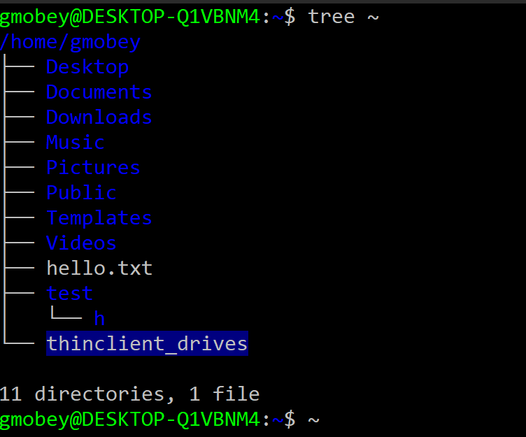
Showing a directory tree
If installed, the tree command shows a directory tree.
Example: tree ~
Notes:
Unlike the ls command the tree command shows the directory structure in a tree-like form.

Slide 21
Lab

Slide 22
Practical exercise 3 – T1 and T2
In the accompanying Exercise Guide

Slide 23
Creating files and directories
Creating an empty file can be achieved with the touch command.
Syntax:
Creating a directory can be achieved with mkdir:
Syntax:
$ touch afilename
mkdir | [-pm] | Dir(s)
Option | Action
-p | Creates the directory and those in its path
-m | Sets the mode (permission)
$ mkdir -p a/dir/path
Notes:
Although the command is designed to change timestamps on a file the touch command will create a file if it does not exist yet.
New directories are created with mkdir specifying the directory to be created (absolute or relative).
The -p option in:
$ mkdir -p a/directory/path
…allows to create the three directories in one go ie: all the directories in the path.
The -m option in:
$ mkdir -m 222 secure-dir
…allows to create a directory with a specified set of permissions (mode).

Slide 24
Copying files and directories
Use the cp to copy file(s) to target file or directory.
If more than one source file is specified, then target must be a directory.
Need write permission on the target file to overwrite it.
cp | [options] | source |  | target
Option | Action
-i | Interactive checking (prompts if target exists)
-r | Copy directories recursively
-f | Forced, no prompt or interaction
cp | [options] | source(s) |  | targetdir
$ cp /etc/passwd a filename
$ cp -i /etc/p* .
$ cp -r . /tmp/myhome
Notes:
Files are copied using the cp command.
If the target is a directory, all source files are copied into that directory.
If the target is a file, a single source file is copied to the specified target.
If the target file already exists, it will be overwritten unless it lacks write permissions. In that case, you must either delete the file or modify its permissions before overwriting. The -f (force) option overrides this behaviour, ensuring the target file is replaced silently.
For example, to copy the /etc/passwd to a file named passwd in the current directory: $ cp /etc/passwd .
And to copy all files from /etc that begin with "p" into the current directory. The -i (interactive) option prompts for confirmation before overwriting an existing file:
$ cp -i /etc/p* .
To copy a directory recursively we must use the –r option. For example, to copy the current directory to /tmp/myhome. This will ensure all sub-directories and files are included: $ cp -r . /tmp/myhome

Slide 25
Renaming (moving) files and directories
Use the mv to copy file(s) to target file or directory.
If more than one source file is specified, then target must be a directory.
The mv command is automatically recursive.
mv | [options] | source |  | target
Option | Action
-i | Interactive checking (prompts if target exists)
-f | Forced, no prompt or interaction
mv | [options] | source(s) |  | targetdir
$ mv passwd /tmp/mypass
$ mv -i file1 /tmp/mypass
mv: replace ‘/tmp/mypass’?
$ mv . /tmp/myhome
Notes:
Files are moved or renamed using the mv command, which changes the full pathname of a file.
If the source and target filenames are in the same directory, the operation is considered a rename.
If the source and target are in different directories, it is considered a move.
If the target file already exists (and is not a directory), it will be overwritten.
To prevent accidental overwriting, use the -i (interactive) option, which prompts for confirmation before replacing an existing file. Even if a file has no write permissions, it can still be overwritten because the operation is handled at the directory level (i.e., the directory’s permissions determine whether a file can be moved or replaced).
To force overwriting without confirmation, use the -f (force) option.

Slide 26
Removing files and directories
Use the rm command to remove files or directories.
To delete an empty directory, you can use rmdir.
rm | [options] | target
Option | Action
-i | Interactive checking (prompts if target exists)
-r | Removes directories recursively
-f | Forced, no prompt or interaction
$ rm mypass
$ rm -i my*
$ rm -r /tmp/myhome
$ rmdir a
rmdir:'a': Directory not empty
$ rm -r a
Notes:
Files are deleted using the rm (remove) command.
Write-protected files: rm prompts for confirmation before deletion.
Interactive deletion: Use the -i option to prompt for confirmation before deleting each file.
Recursive deletion: The -r (recursive) option deletes a directory and all its contents, including subdirectories.
Without -r, rm will not delete directories, even if they are empty
For example, to remove a single file – with no prompting or undo:
$ rm datafile
And to interactively prompt before removing the file:
$ rm -i datafile
And to recursively remove a directory (assuming permissions will allow) and its contents:
$ rm –r Documents

Slide 27
Practical exercise 3 – T3 and T4
In the accompanying Exercise Guide

Slide 28
i-nodes

Slide 29
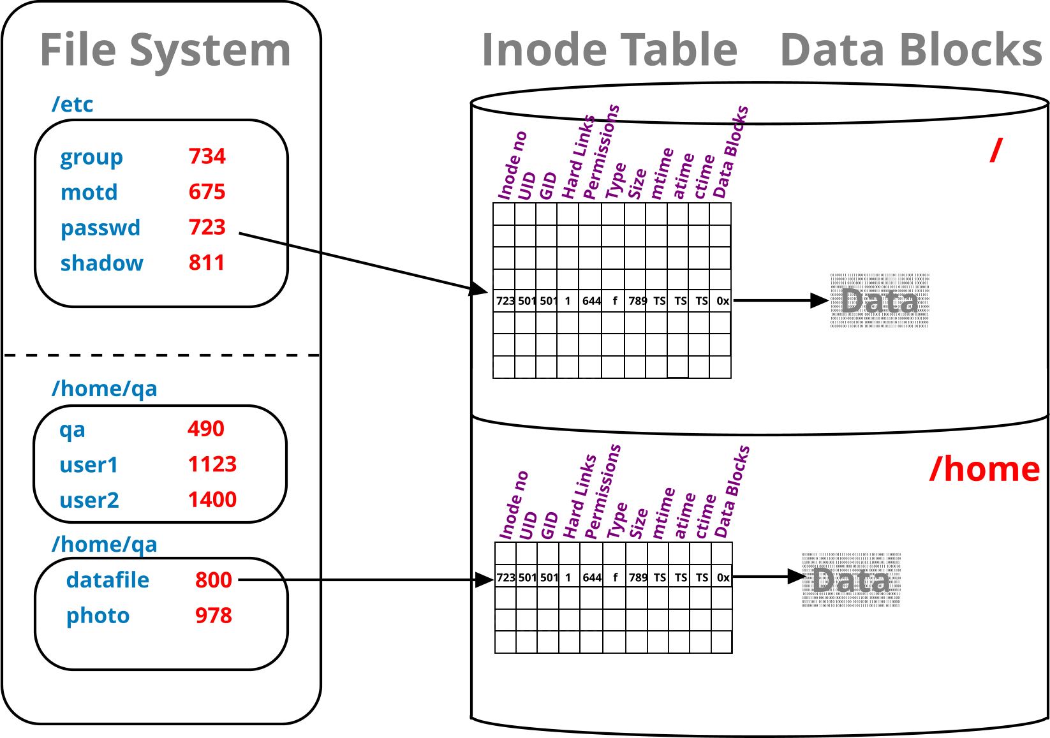
Filesystems, i-node tables, and directories
UNIX and Linux disks are typically partitioned, each containing a file system.
Each partition (filesystem) has its own i-node table.
i-nodes point to the data-blocks.
Directories map filenames to i-node numbers.
Notes:
Linux and Unix disks are often partitioned (for ease of maintenance and a choice of filesystem types).
Each partition is high-level formatted (process that applies a filesystem).
Both Linux and UNIX supports several different types of filesystem
On Unix ufs, jfs and vxfs are the most popular ones, whereas on Linux we use the family of ext? file system types (ext2, ext3 and ext4) as well as xfs, zfs, gvfs, reiserfs and btrfs.
The resulting filesystem has its own i-node table, which in turn, contains one record (i-node) for each file or directory on this filesystem.
Conversely, each file has one allocated i-node containing all the file information (including pointers to the file or directory data blocks).
The only file attribute not stored on the i-node is its name.
The filename is stored in the directory containing the file.
In other words, directories simply relate names to i-node numbers.

Slide 30
Looking inside i-nodes
I-nodes store most file attributes, Except for the file name, which is stored in a directory.
i-node can be explored with the stat command…
…or via ls using the –i and –l switches.
i-node numbers are unique within a partition / filesystem.
$ stat script1.bash
File: script1.bash
Size: 237 Blocks: 8 IO Blocks: 4096 regular file
Device: 802h/2050d Inode: 77909 Links: 1
Access: (0755/-rwxr-xr-x) Uid: (501/hal9000) Gid: (500/cyber)
Access: 2000-01-30 13:22:36.000000000 +0000
Modify: 2000-01-30 13:22:36.000000000 +0000
Change: 2000-01-30 13:22:36.000000000 +0000
$ ls -li script1.bash
77909 –rwxr-xr-x. 1 hal90000 cyber 237 Jan 30 2000 script1.bash
Notes:
The stat command, like ls -l, provides access to the inode table contents. However, stat offers more detailed and comprehensive information than ls, including lower-level logical block details and additional file attributes.
One of the key advantages of stat is its ability to display all three timestamps maintained for each file and directory:
Access time (atime): Records when the file was last opened for reading.
Modification time (mtime): Indicates when the file's contents were last changed.
Change time (ctime): Tracks when the inode itself was modified, rather than the file content. This occurs when file attributes such as ownership, permissions, or size are altered.
By using stat, users can gain deeper insight into file activity and system changes beyond what ls -l provides.

Slide 31
Links

Slide 32
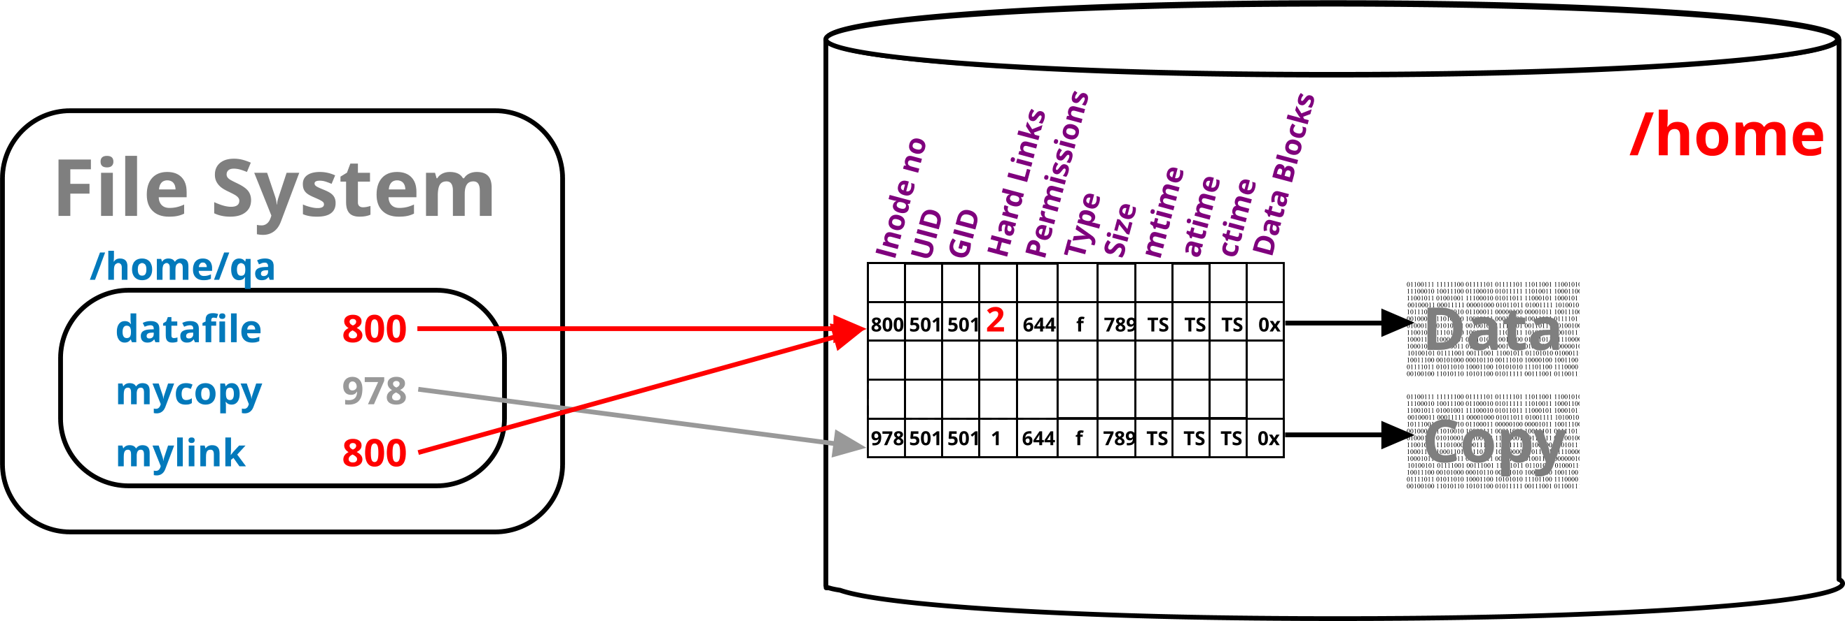
Hard links
Directories map file names to i-node numbers.
Each of these count towards a file’s link count.
Stored in the file’s metadata/i-node
Effectively a count of the names a file has
This is called a hard link.
The i-node is partition bound.
And thus, the hard link is too
Directories naturally have a higher link count.
Three plus one per directory within it
Manually created hard links can only refer to files.
$ cp datafile mycopy
$ ln datafile mylink
$ ls -li datafile mylink mycopy
800 –rwxr-xr-x. 2 qa qa 1402 Jan 30 12:24 datafile
978 –rwxr-xr-x. 1 qa qa 1402 Jan 30 12:28 datafile
800 –rwxr-xr-x. 2 qa qa 1402 Jan 30 12:24 mylink
Notes:
All UNIX and Linux filesystems, implement the concept of a link, which mean that several names can be associated with one i-node number.
All UNIX and Linux filesystems support the concept of links, allowing multiple filenames to be associated with a single inode.
A hard link is essentially a directory entry that points to an existing inode. Since all links share the same inode, they reference the same data on disk. This means changes made to a file through one hard link are immediately reflected in all other hard links to that file.
When a hard link is removed, the system decreases the link count for the associated inode. If the link count reaches zero, meaning no directory entries reference the inode anymore, the system deallocates the inode and frees the storage space. This is why the command to remove a file is called rm (remove) rather than delete, as files persist until all links to them are removed.
In the example on the slide, the file mycopy is a copy of datafile and is assigned a new i-node and its own data blocks. Whereas the mylink file is created using the ln command and the file system assigns the same i-node as datafile and therefore sharing the same attributes and data. The file system will increment the hard link count by 1.

Slide 33
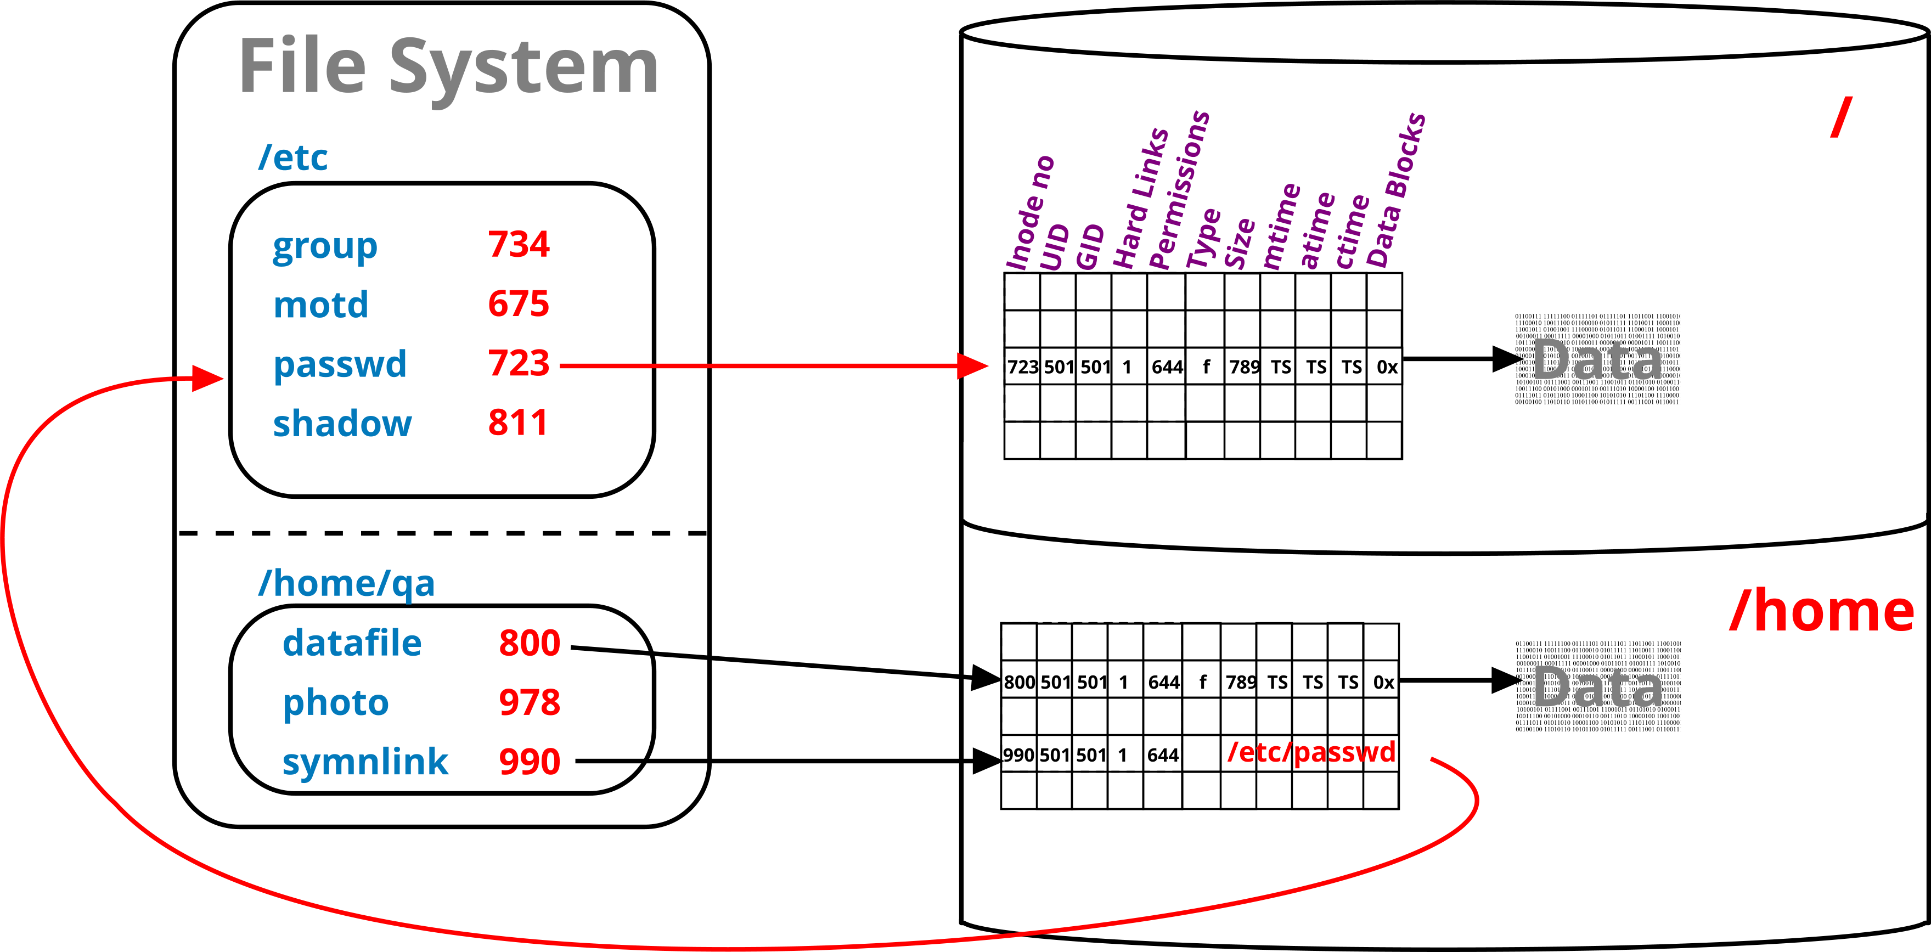
Symbolic links
A special file that refers to (points to) another by its path
Thus, can span partitions / file systems
Relative or full paths can be used
Full path is recommended
$ ln -s datafile softlink
$ ls -li datafile softlink
800 –rwxr-xr-x. 2 qa qa 1402 Jan 30 12:24 datafile
990 lrwxrwxrwx. 2 qa qa 8 Jan 30 13:21 softlink -> datafile
Notes:
Hard links have two main limitations: they cannot be created for directories (as this would cause loops in the filesystem hierarchy) and they cannot span across different filesystem partitions (since each partition has its own separate inode table).
To overcome these restrictions, Linux provides symbolic links. Unlike hard links, which share the same inode as the target file, symbolic links store the pathname of the target file within their own inode. This behaviour is similar to shortcuts in Windows.
Since symbolic links reference pathnames rather than inodes, they can link to both files and directories and can span across different filesystem partitions. They also consume minimal disk space, typically requiring only an inode entry and, for longer pathnames, additional data blocks. However, there is a slight performance overhead, as the kernel must resolve the stored pathname back into the filesystem to locate the actual file.

Slide 34
Hard links and symbolic links compared
Hard links translate file names to i-node numbers
Pointing to entries in the i-node table
Symbolic links refer to where a file is / was
The path can be relative or, preferably absolute
directory
i-node table
Data-blocks
file1 (136220)
file2 (136220)
file3 (136224)
136220
136324
The file’s data
Path to file ->

Slide 35
Creating links
(Use ls command to confirm changes.)
The file being linked to, must exist, at the time the link is created.
Remove links with rm.
A file is deleted when the last hard link is removed.
ln |  | source |  | target
ln | -s | source |  | targetpath
$ ln file1 file2
$ ln -s file1 file3
$ ls -il file[1-3]
77642 -rw-r--r-- 2 user1 other 243 ... file1
77642 -rw-r--r-- 2 user1 other 243 ... file2
77645 lrwxrwxrwx 1 user1 other 5 ... file3 --> file1
$ ls -ilL file3
77642 -rw-r--r-- 2 user1 other 243 ... File3
Notes:
The example above illustrates the creation of two link files: a hard link, and a symbolic link.
Hard link is just another name pointing at the same i-node entry as the original filename.
The moment the hard link has been created, the idea of an original and new name ceases to exist.
Both names can be used to perform all allowed operations on the file. However, neither of the names can be moved into a different filesystem without destroying the link between them.
The symbolic link points at the logical name, rather than physical address of the file, it can be moved about without breaking the connection with the original.
However, if the “original” file is removed, the symbolic link breaks, and will report that file does not exist when you try to access it.

Slide 36
Review and lab

Slide 37
Review questions
What is the basic difference between a hard link and a symbolic links?
What is meant by a recursive operation on a directory?
What is the purpose of the /etc directory?
What is an absolute (full) pathname?
Which two commands allow to remove directories?
Scenario: You created a symbolic link file called symfile to a text (source) file. Subsequently, you have removed the source file. What will happen if you run cat symfile command?
Notes:
Hard link is an additional entry in a directory, pointing at the same i-node number. Symbolic link is a file in its own right, with the contents set to the name (logical address) of the original file.
Recursive means a repetitive application of a command; it usually means that you apply a command to the given directory and its entire content (the command will descend to the bottom of the directory branch).
It contains system configuration files.
A location of a file referenced to the root of the filesystem (/). For example: /etc/default/sudo is an absolute (full) pathname, whereas etc/default/sudo is a relative pathname (relative to your current location)
rmdir can remove a directory (although it can only handle empty ones) rm –r can also remove a directory, complete with its content
You will get an error message saying: “cat: symfile: No such file or directory”.

Slide 38
Practical exercise 3 – T5
In the accompanying Exercise Guide

Slide 39
Summary
Linux directory layout follows FHS.
Data is stored in files; files are grouped in directories
The home directory is where you are after logging in
Absolute pathname starts with the leading '/‘
Relative pathname is with respect to the current directory
Files and directories can be managed with basic tools.
Files can be accessed through alternative names (links).
Hard link, within the same filesystem
Symbolic link, contains logical address of the original
Files have attributes.
Stored on disk, in i-node table

